Slide 1
AWS – Overview
April 2016

Slide 2
Version Sheet: MANDATORY (hidden in ‘slide show’ mode)
Version | Changes | Author
001 | Redesign | Rohan Salvi

Slide 3
Note to the SME:
Note to the SME:
This is a temporary slide and will not be part of the final upload at all. It is to help the SME understand how we will communicate changes to them.
Please read before you begin reviewing this module as SME
Dark Red box with white text
Note to the SME
The SME must provide missing info.
Amber box with black text
Note to the SME
The SME must validate the re-design/ the modification/ addition.
To Review and Navigate the comments in the presentation Click on the “Review” Tab and then Click “Next” to review all the comments . Also you can add your comments using the “New comment” button
The comments in the review section have also been updated in a green textbox with black text.
.

Slide 4
Ground Rules for Face-to-face Classrooms
Everyone participates
Respect individual opinions and diversities
Be open and honest
Give headlines, be concise
One speaker at a time
Make language a non-issue
Stick to time contracts
Seek first to understand, and then to be understood
Clean desk / room policy
No mobile phone,
No computer (except for surveys, polls etc)
Clients & Leadership are often around, please remember that
Maintain a spirit of fun and enthusiasm
Notes:
Best to print on an A3 sheet and display in class. The idea is to co-create, to connect to learn, to do-learn-do (knowing is not enough, the real purpose is to apply what we learn on the job). It would also be great to have the class share their learning with their teams. You are the facilitator, you will help all share knowledge and learn new concepts or skills, there will be no lectures, everyone is a teacher.

Slide 5

Ground Rules for Virtual Classrooms
Wait for others to finish speaking before you speak
Each time you speak, state your name
Build on others’ ideas and thoughts
Disagreeing is OK –with respect and courtesy
Participate actively in each session
Share experiences and best practices
Bring up challenges, ask questions
Discuss successes
Respond to whiteboards, polls, quizzes, chat boxes
Hang up if you need to take an urgent phone call, don’t put this call on hold
As a best practice…be just a few minutes early!
Communicate professionally with others
Mute when you’re not speaking
Be on time for each virtual session
Notes:
Show this slide and hide the one for onsite classrooms, if this is a virtual session.
ONLY for Virtual classrooms

Slide 6
Module at a Glance
SME to provide the details required in the table.
Target Audience:
Course Level: | Basic
Duration (in hours): | 30 mins
Pre-requisites, if any: | NA
Post-requisites, if any: | Submit Session Feedback
Relevant Certifications: | None

Slide 7
Introductions (for Virtual Classrooms)
SME to provide the photos and names of the facilitators.
Business Photo
Business Photo
Facilitator
Name
Role
Moderator
Name
Role
Notes:
Add pics and Capgemini roles for the Facilitator and moderator. Establish their credibility, what qualifies them to facilitate this session.

Slide 8
Course Map
The History so far
1
AWS Global Infrastructure
2
Concepts & Components – Part 1
3
Concepts & Components – Part 2
4
Concepts & Components – Part 3
5
AWS Icons
6

Slide 9


Module Objectives
Note to the SME : Please provide the module Objectives or validate the partially updated content
What you will learn
At the end of this module, you will learn:
What is AWS
What you will be able to do
At the end of this module, you be able to:
Explain what is AWS
History of AWS
Understand the AWS Global Infrastructure
Describe the various types of Amazon Services
Describe about AWS platform

Slide 10
Power of AWS
Invention requires two things :
The ability to try a lot of experiments and
Not having to live with the collateral damage of failed experiments

Slide 11
A Brief Time Line of AWS
2003 - Chris Pinkman & Benjamin Black present a paper on what Amazon’s own internal infrastructure should look like .
Suggested selling it as a service and prepared a business case .
SQS officially launched in 2004.
AWS officially launched in 2006.
2007 over 1,80,000 developers on the platform.
2010 all of amazon.com moved over .
2012 First Re-Invent Conference .

Slide 12
Contd.,
2013 Certifications Launched.
2014 Committed to achieve 100% renewable energy usage for its global footprint .
2015 AWS breaks out its revenue , $6 Billion USD per annum and growing close to 90% year on year .

Slide 13
AWS – New Service Announcements & Updates

Slide 14
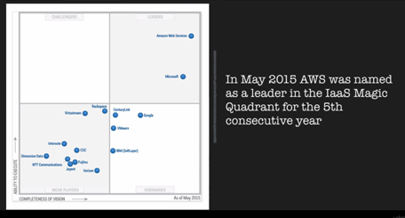
Gartner’s Magic Quadrant

Slide 15











Concepts and Components - The AWS Platform

Slide 16
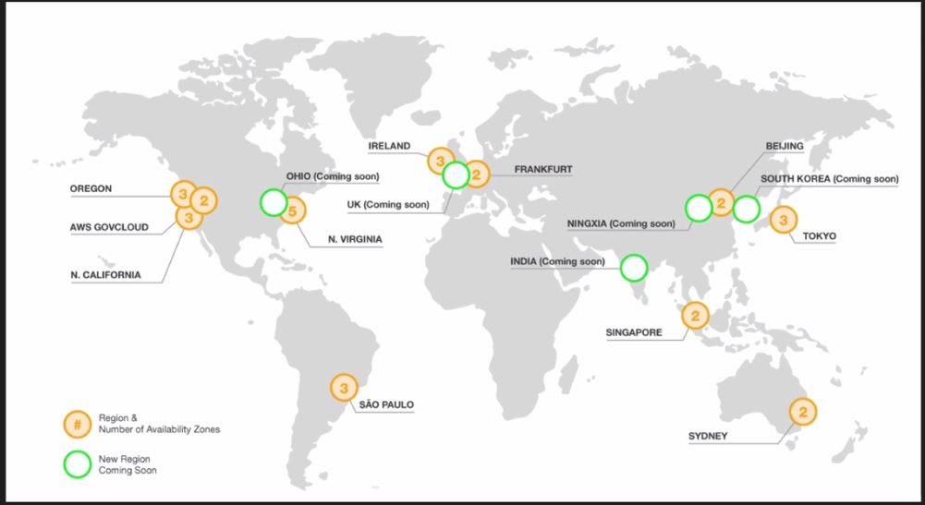
AWS Global Infrastructure
11 Regions & 30 Availability Zones – December 2015
5 More Regions & 10 More Availability Zones – 2016

Slide 17
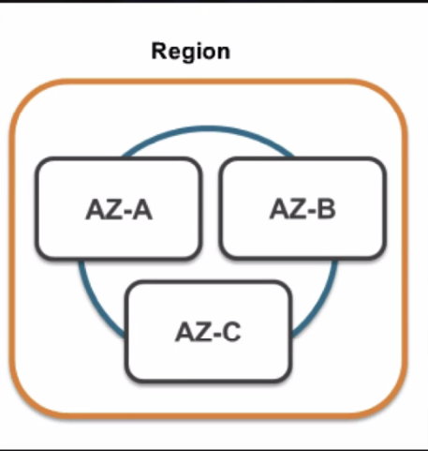
What is a Region ? What is an AZ ?
A Region is a geographical area. Each Region consists of 2 (or more) Availability Zones
An Availability Zone (AZ) is simply a Data Center

Slide 18
Edge Locations
Edge Locations are CDN End Points for Cloud Front
There are many more Edge Locations than Regions
Currently there are over 50 Edge Locations

Slide 19
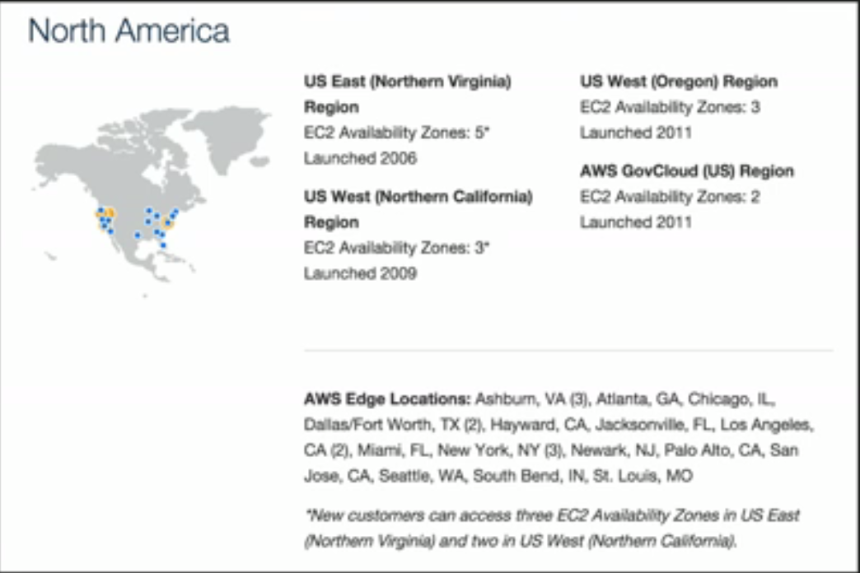
A Brief Look at Today’s Regions

Slide 20
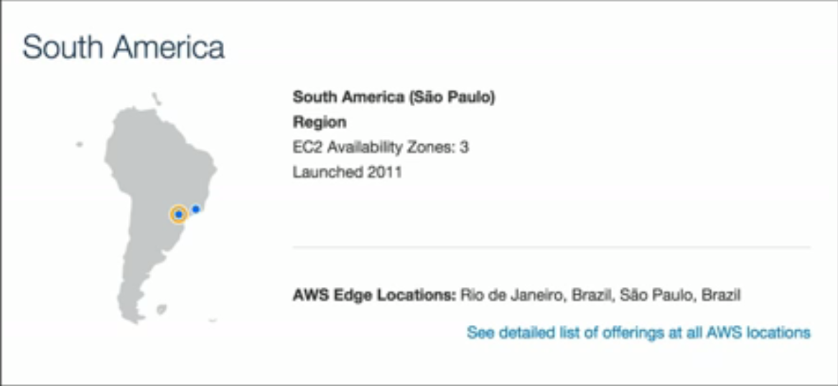
Contd.,

Slide 21
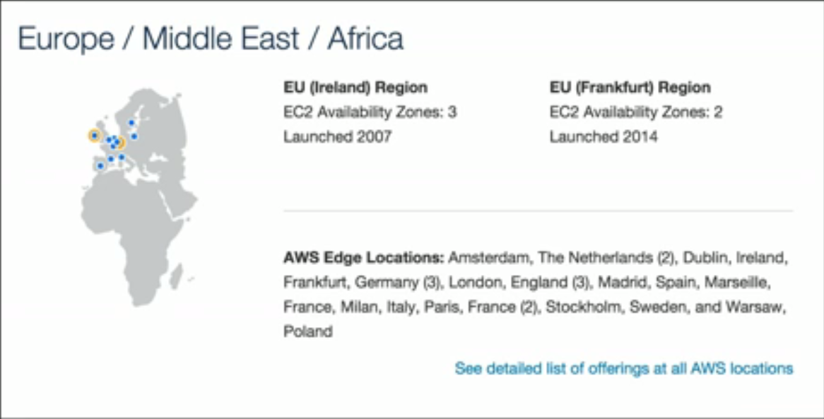
Contd.,

Slide 22
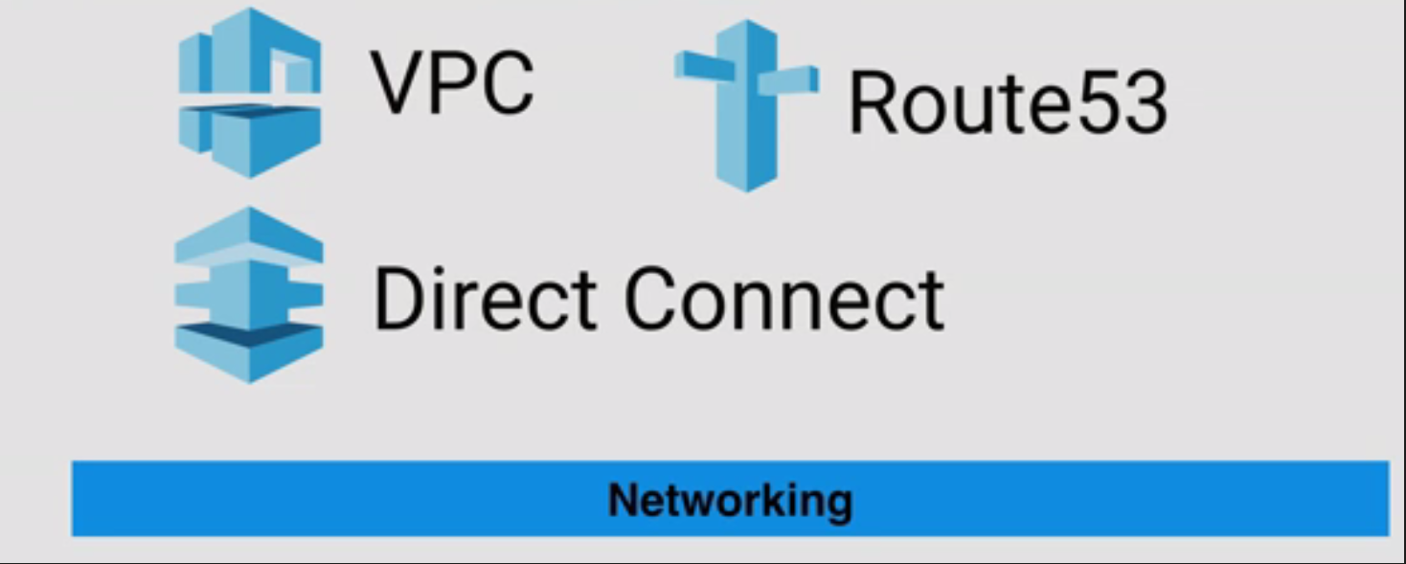
The AWS Services

Slide 23
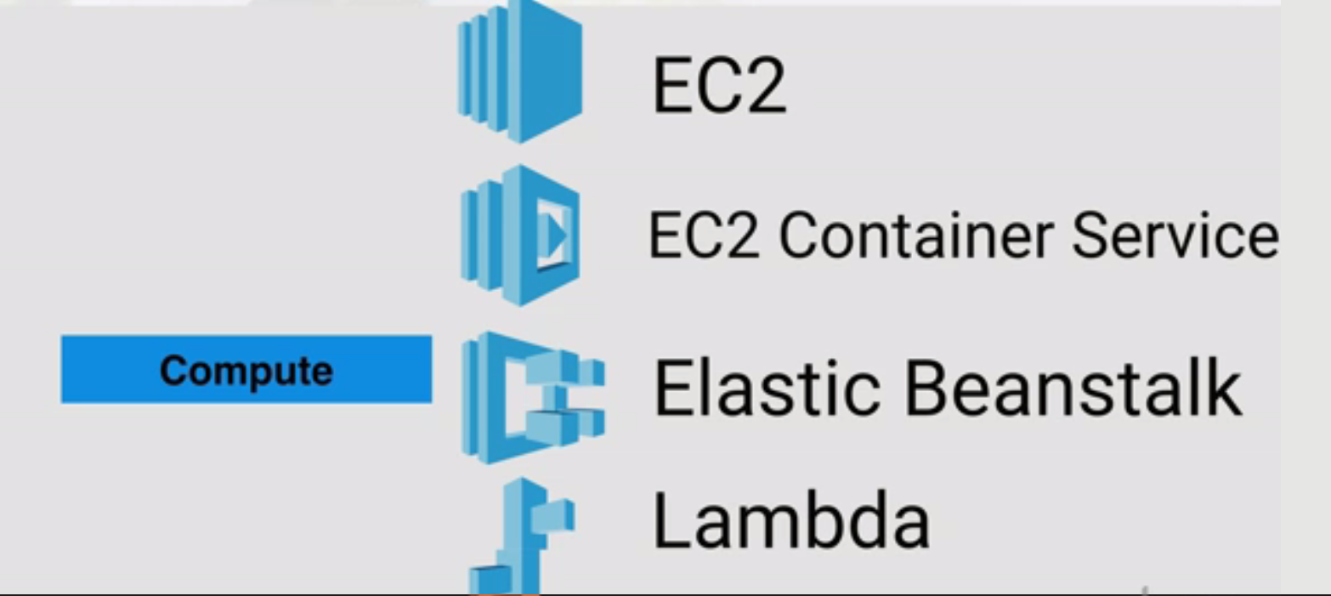
AWS Services

Slide 24
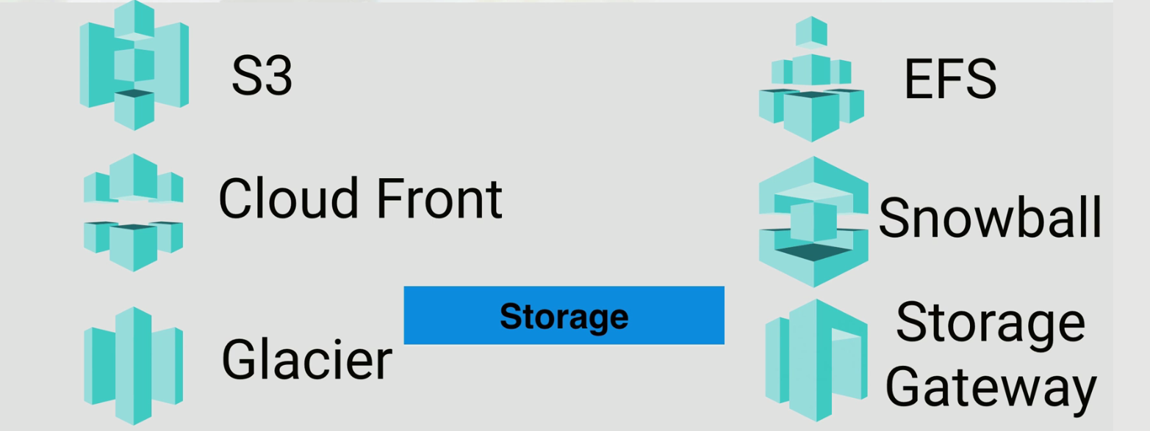
AWS Services

Slide 25
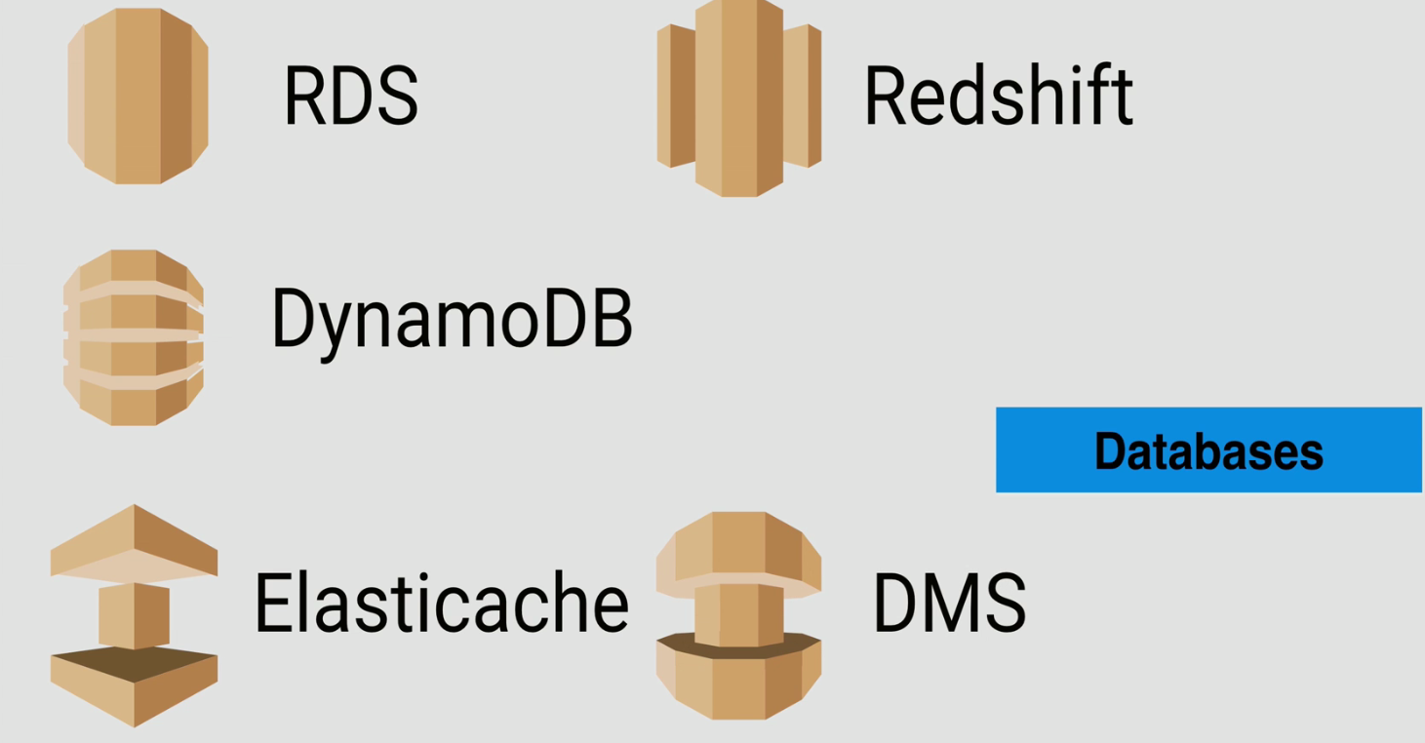
AWS Services

Slide 26
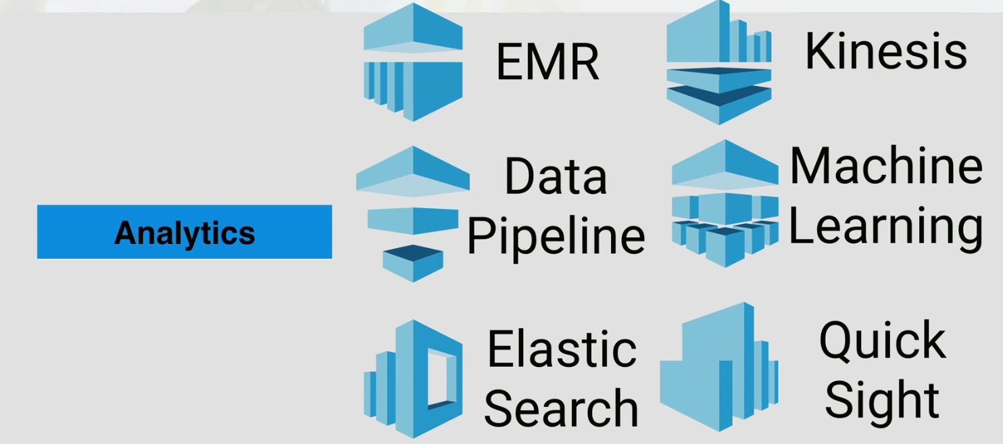
AWS Services

Slide 27
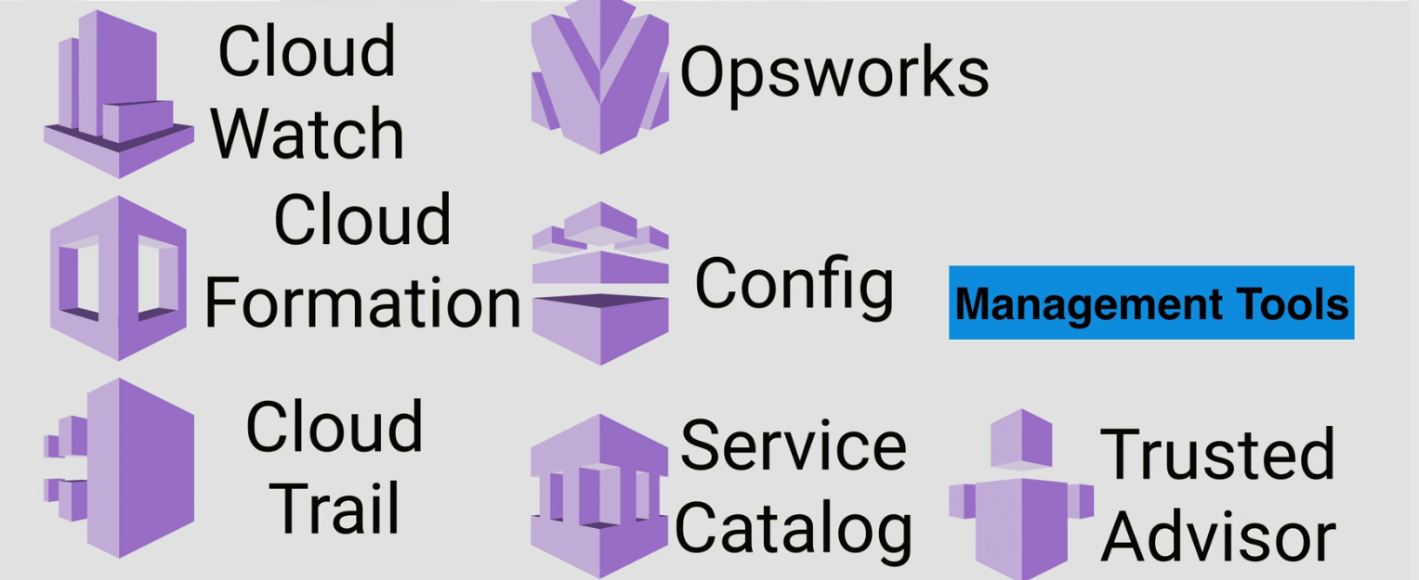
AWS Services

Slide 28
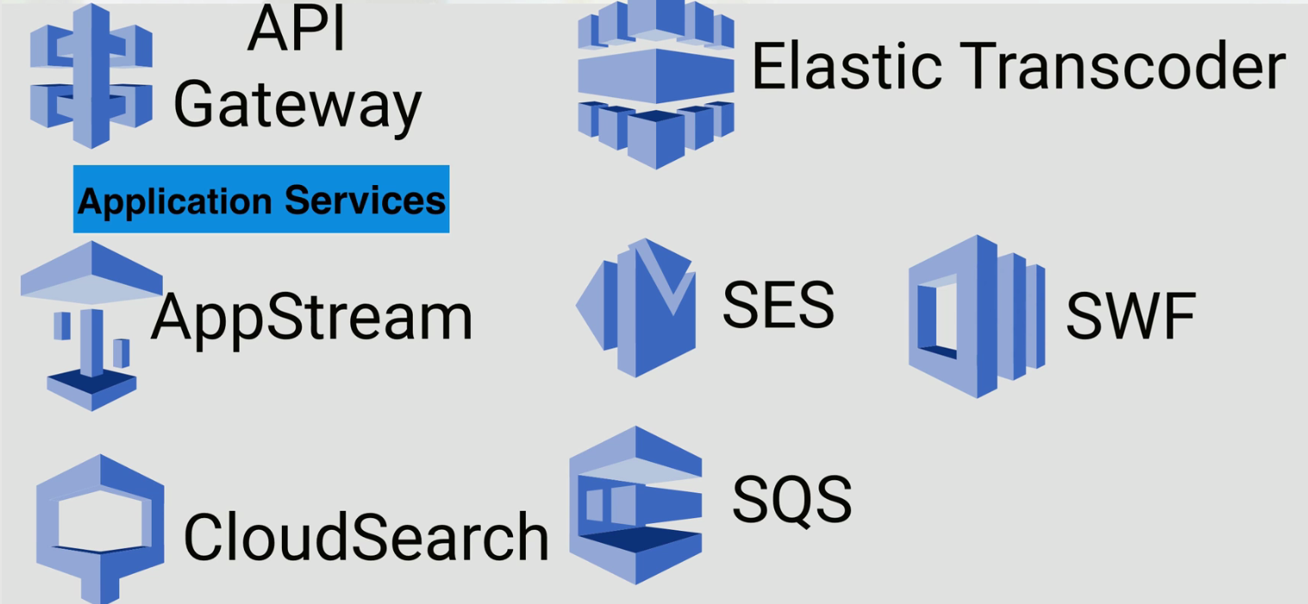
AWS Services

Slide 29

AWS Services

Slide 30
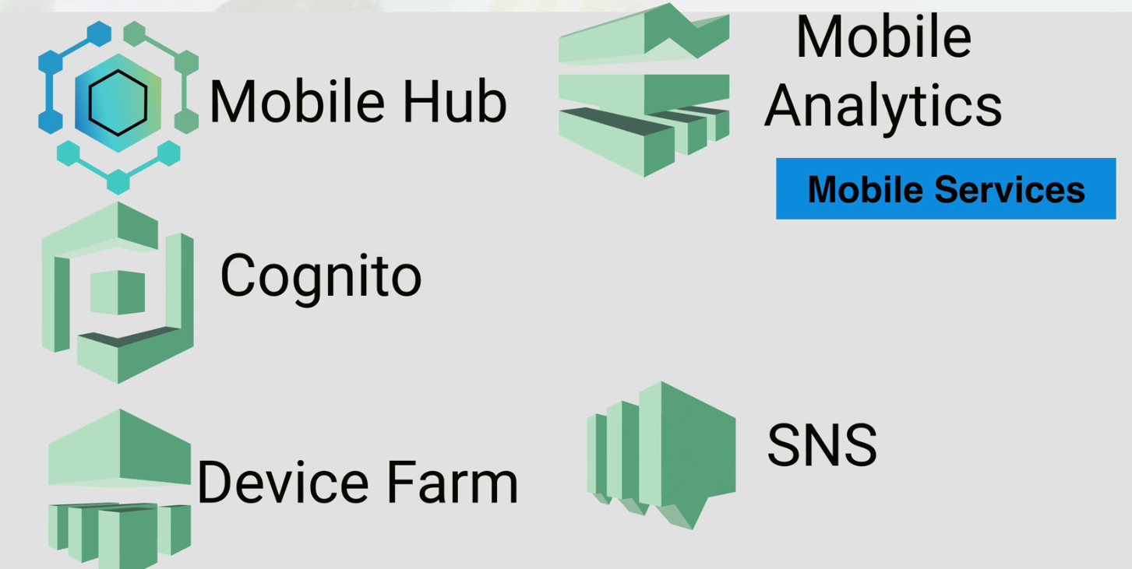
AWS Services

Slide 31
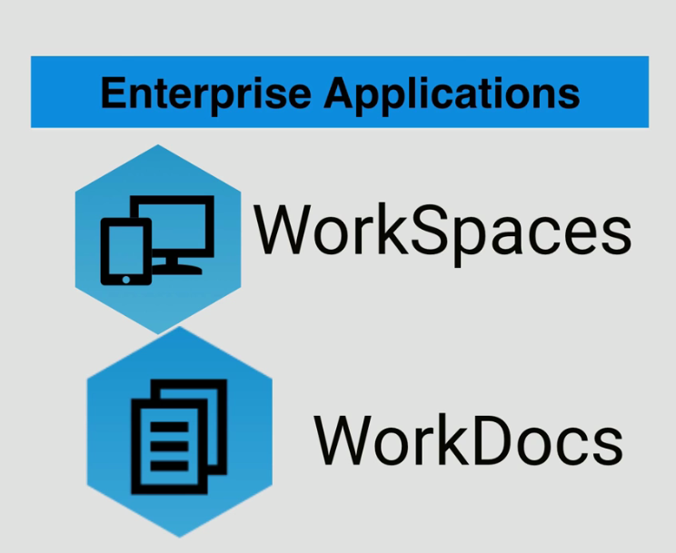
AWS Services

Slide 32


AWS Services

Slide 33
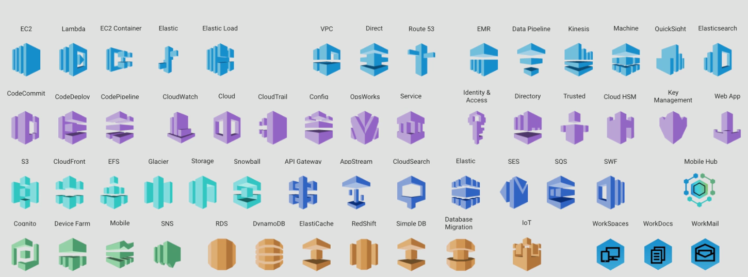
Icons of AWS Services

Slide 34
Summary
History So Far
AWS Global Infrastructure
Regions, Availability Zones ,Edge Locations
Concepts and Components – Part 1
Concepts and Components – Part 2
Concepts and Components – Part 3
AWS Platform

